Slide 1
Chapter 9 Heat and States of Matter
Section 2– States of Matter

Slide 2
Four States of Matter
The four states of matter include:
Solid
Liquid
Gas
Plasma
The differences between the four states are due to differences in the attractions of their particles.

Slide 3
Four States of Matter
1 Solid
Particles are packed closely together
Particles are constantly vibrating in place
Attractions between particles is very strong
Have a fixed volume and shape
2 Liquid
Particles can slide past each other allowing the liquid to flow
and take the shape of its container
Attractions between particles are strong but not as strong as
in solids; particles cling together
Have a fixed volume but not a fixed shape
3 Gas
Particles are much farther apart than liquids and solids
Attraction between particles is weak; particles no longer cling
together
Have no definite shape or volume; particles spread out until evenly
distributed (diffusion)

Slide 4
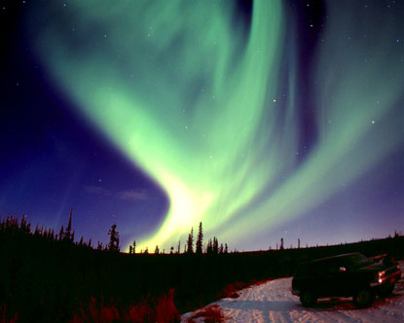
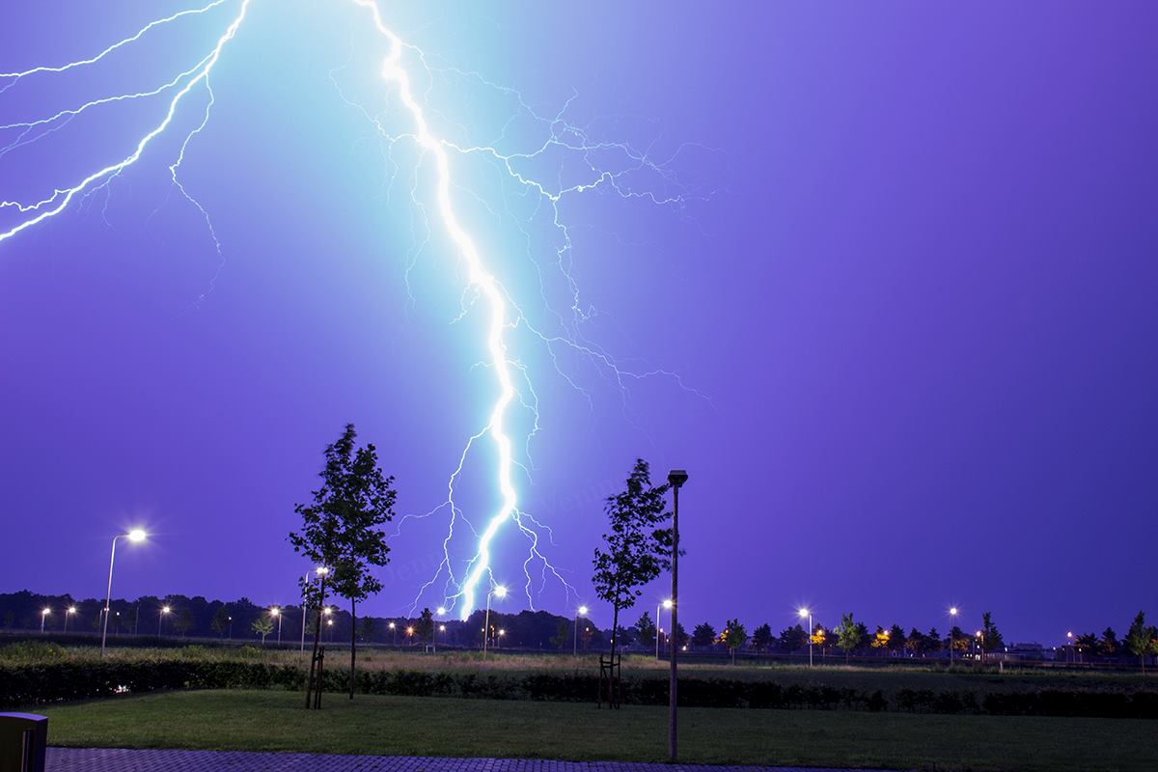
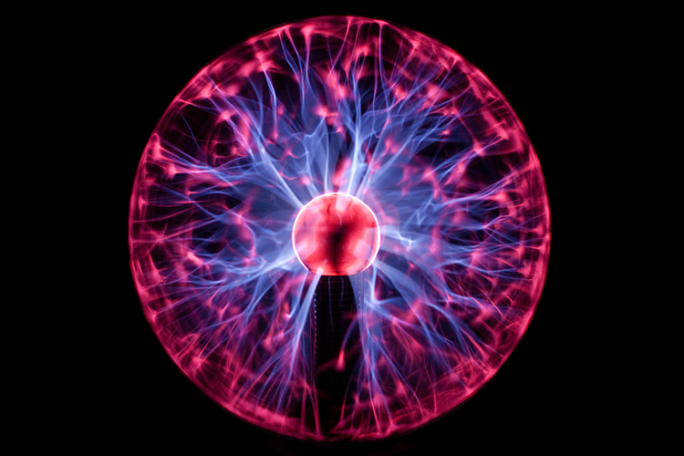
Four States of Matter
4 Plasma
Matter consisting of positively and negatively charged particles
The most common state of matter in the universe
Does not have a definite shape or volume
Examples of plasmas include:
Lightning
Stars
Neon and fluorescent tubes
Auroras

Slide 5
Changing States
Changes in thermal energy of a material can cause it to change from one state to another.
Melting – When energy and temperature increase causing a solid to turn into a liquid. The particles of the solid move faster and the attractive forces between them weaken.
Freezing - When a liquid loses/decreases its energy and temperature causing the particles to move slower and strengthen its attractive forces… and turns into a solid.
Vaporization – When a liquid gains/increases its energy and temperature causing the particles to move faster and the particles to no longer cling together and turn into a gas.
Evaporation – Vaporization on the surface of a liquid
Boiling – Vaporization throughout an entire liquid.

Slide 6
Changing States
Condensation – When a gas turns into a liquid due to a loss/decrease of energy and temperature; the kinetic energy decreases and the particles cling back to each other.
Sublimation– When a solid skips the liquid states and turns directly into a gas because of an increase in thermal energy and temperature.

Slide 7
Changing States

